Slide 1
Country Status of quality management in rainfall observation
Presenter’s name
Presenter’s name
Country report in RAII WIGOS workshop on quality management of observation held in Tokyo, March 2018

Slide 2
1. Challenges in rainfall observation
Lack of the skilled experts for the maintenance to keep the accuracy of rainfall observation
Absence of real-time observation report
Little knowledge for the quality control after the observation
In this slide, please appeal the challenges / difficulties you feel in rainfall observation.
And in the following part of this report, please describe in detail when the topic relates to the above challenges / difficulties.

Slide 3
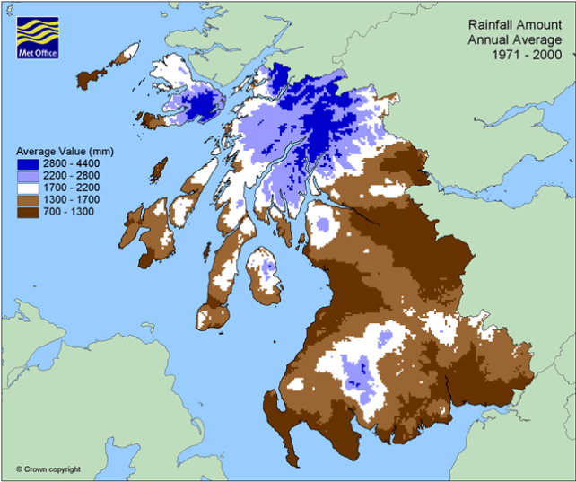
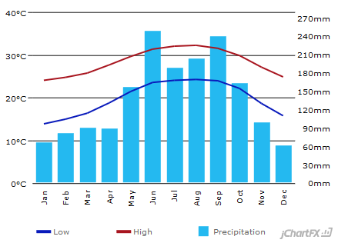
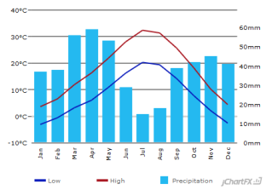
2. Annual rainfall map
Monthly rainfall in City AAA
Monthly rainfall in City BBB
Annual average rainfall map and monthly average rainfall graphs at some characteristic cities are to be placed in this slide.

Slide 4
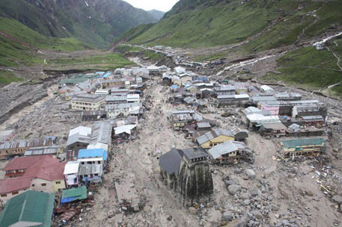
3. Major recent rainfall-related disaster
201x-Month-Day ← date of disaster
Landslide, flood ← type of disaster
North of ZZZZ ← area of country or City name
Max over 500mm rainfall in 24hour , area average 300mm in 2days ← rainfall amount
Over 5000 people killed, over 10000 houses destroyed ← number of damage
Outline of major recent rainfall- related disaster is to be described in here. If available, a rainfall map is one of preferable materials.

Slide 5
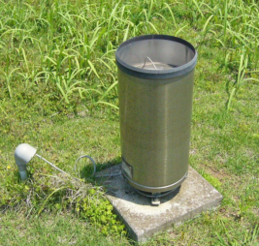
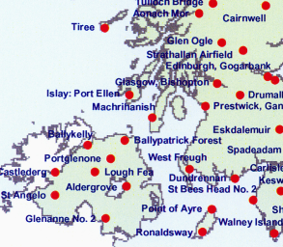
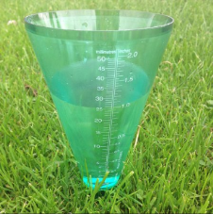
4. Rain gauge network
Blue circles represent the automatic rain gauge stations.
Tipping bucket rain gauge is used in the station.
It observes rainfall every 10 minutes and transmit the data every 1 hour.
Minimum observation unit is 0.2mm.
Statistical data are stored since April 2004.
Rain gauge network map and the type of rain gauge are to be described in this slide. Other essential information (frequency of observation and report, minimum observation unit, period of statistical data) are also to be described.
If radar observation is available, it is also to be described in this map.
Red circles represent the manned rain gauge stations.
Conical graduated cylinder is used in manned station.
Observers read the rainfall value every 6 hour and report the data once a day.
Minimum observation unit is 0.5mm.
Statistical data are stored since October 1980.

Slide 6
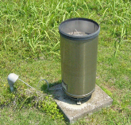
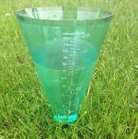
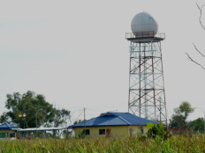
5. Applications and users
In this slide, it should be described how the observation data are sent to the user and how the data are utilized.
XXX’s headquarters
Automatic rain gauge data are transmitted to headquarters every 1 hour.
Manned observed rain gauge data are reported to headquarters once a day.
Warning/Watch/Advisory for the stakeholder
Monthly rainfall map for the agricultural organization of government
Data center in headquarters conducts AQC and archiving statistical data.
Observation data in real-time web for the nations
Agricultural instruction for the nations

Slide 7
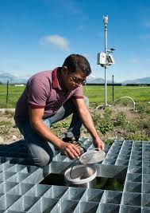
6. Quality management
conduct following quality management operations.
Rain gauge inspection once a year
Site environmental check once in every two years
Daily site appearance check
Limited value check for the observation data
Training course for the observer
In this slide, please appeal your operations for the quality management of rainfall observation data.

Slide 8
7. Expectation for this workshop
Knowing how to adopt quality management
Getting some skills of quality control for observation data
Getting some tools of AQC and HQC
Getting some materials for lecturing about quality management in my office
Making firm relationships between participants to exchange useful information after the workshop
In this slide, please describe what you expect to acquire in this workshop.

